Slide 1
Office of Civil Rights Compliance (OCRC)
New Employee Orientation

Slide 2
OCRC
We cultivate a culture of respect by honoring individuals’ civil rights within our campus community.
Value statements:
  Approachable. Seek to understand and offer compassion.
  Neutral. Share information, resources, and options in an impartial manner.
  Fairness. Provide a process where everyone is heard and valued.
  Integrity. Commit to transparency and honesty.
  Respect. Show kindness by honoring the feelings, wishes, and rights of others.
Office of Civil Rights Compliance

Slide 3
Functions of OCRC
Oversee equal opportunity efforts
Resolve issues of Harassment and Discrimination
Serve as liaison to outside agencies regarding civil rights complaints and contract compliance
Coordinate Title IX efforts on campus
Report to the University President
Office of Civil Rights Compliance

Slide 4
What is...
Policy 13.02 -
Discrimination,
Harassment, and
Sexual Misconduct
Discrimination
Occurs when an individual is treated adversely because of their membership in a protected class
Harassment
Unwelcome behavior
Creates a hostile or intimidating environment
Makes it difficult or impossible to learn or work
Retaliation
Taking adverse action against someone participating in a protected activity
Action taken because of their participation in that protected activity
Office of Civil Rights Compliance

Slide 5
Protected Classes
Age
Color
Creed
Disability
Ethnicity
Genetic Information
Marital Status
National Origin
Political Affiliation
Pregnancy
Race
Religion
Sex
Sexual Orientation
Veteran or Military Status
Any other Basis Protected by Federal and/or State Law
Office of Civil Rights Compliance

Slide 6
Pregnancy
Working with students who are pregnant:
  Division of Student Life
    102 Gilchrist Hall
    studentlife@uni.edu
    (319)273-2332
Employees who are pregnant:
  Human Resource Services
    027 Gilchrist Hall
    hrs-leaves@uni.edu
    (319)273-2927
Office of Civil Rights Compliance

Slide 7
Title IX
Prohibits discrimination based on sex in all programs and activities of the University.
Our institutional responsibility is to provide prompt and effective remedy once we have knowledge of allegations related to such discrimination.
Office of Civil Rights Compliance

Slide 8
Sexual Misconduct
Includes the Following:
Quid Pro Quo Sexual Harassment
Hostile Environment Sexual Harassment
Sexual Assault
Dating Violence
Domestic Violence
Stalking
Sexual Exploitation
Office of Civil Rights Compliance

Slide 9
Consent
Knowing, voluntary, and clear permission to engage in mutually agreed-upon sexual activity.
It is the responsibility of each party to ensure that the other has consented before engaging in the activity.
An individual can withdraw consent at any time.
Office of Civil Rights Compliance

Slide 10
Consensual Relationships
Consensual romantic and/or sexual relationships where a power differential exists, whether real or perceived, may constitute sexual harassment.
All University employees are strongly discouraged from entering into romantic and/or sexual relationships which could lead to the creation of hostile environments.
Office of Civil Rights Compliance

Slide 11
Reporting Responsibilities
University employees who are aware of or who witness discrimination, harassment, sexual misconduct, or retaliation are required to promptly report to the Title IX Officer or Deputy Coordinator.
Students who are aware of or who witness discrimination, harassment, sexual misconduct, or retaliation are encouraged to promptly report to the Title IX Officer or Deputy Coordinator.
Student employees are required to report issues that fall within the context of their on-campus employment.
Office of Civil Rights Compliance

Slide 12
Reporting
Where are the Title IX Officer and Deputies?
  Office of Civil Rights Compliance
    Gilchrist 117
    319.273.2846
    civilrights@uni.edu
  Online Reporting at civilrights.uni.edu and safety.uni.edu
Office of Civil Rights Compliance

Slide 13
Reporting
Whenever you have a concern or question about equity or protected-class issues, you should contact OCRC as soon as possible.
We Listen. We Present Options.
We Resolve Issues on a Case-by-Case Basis.
Office of Civil Rights Compliance

Slide 14
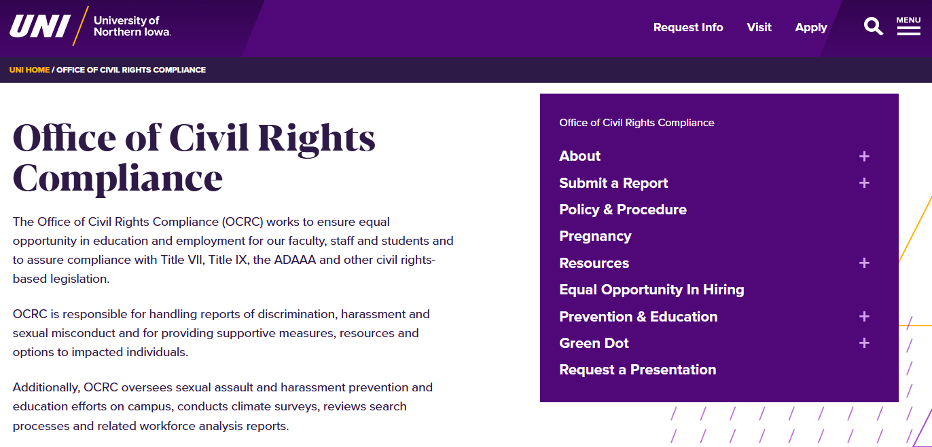
civilrights.uni.edu
Office of Civil Rights Compliance

Slide 15
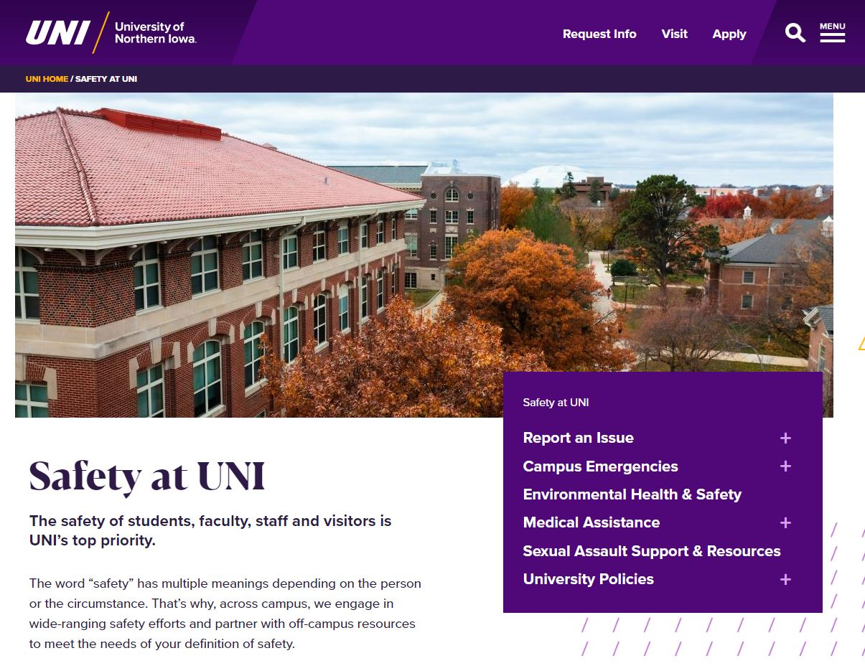
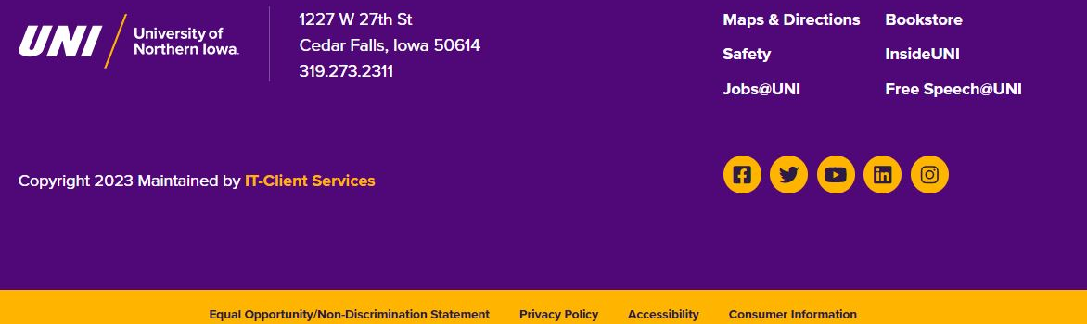
safety.uni.edu

Slide 16
Online Training Assignment
Refer to your assignment email for login directions.
  Always available at training.uni.edu
You can stop and start the assignment at your convenience.
Call OCRC (319-273-2846) with any questions.
Employees are expected to complete this
training at least once every two years.
Office of Civil Rights Compliance

Slide 17

Green Dot is an NISG-sponsored bystander intervention program focused on gender violence prevention. The goal of Green Dot is to decrease the likelihood of sexual assault, stalking, dating and domestic abuse.
All student, staff, and faculty are encouraged to get involved.
Attend a Green Dot Training – sign up at greendot.uni.edu

