Slide 1
Phishing
Don’t get caught!

Slide 2
Old School Phishing example
Dear Staff and student,
This is to inform all staff and student of University of Northern lowa, that due to the congestion in the school web-mail account and removal of all unused accounts an upgrade is needed, kindly update your email account by filling the form below.
User Name
Email Id
Password
Confirm Password
This information will be used to upgrade your account to avoid lost. Failure to do this your account will be De-activated.
Please stay connected.
Thank you.
University of Northern lowa webmail Team.

Slide 3
Any request to divulge your UNI password via email is fraudulent!

Slide 4
Phishing Education Project
UNI embarked on a phishing education venture starting in October 2018. The initial round continued until the pandemic cut everything short in March 2020. We have resumed the project this spring. Simulated but realistic phishing messages are sent periodically to faculty and staff mailboxes by a contracted vendor. Those that respond to these educational messages receive some quick and specific training on recognizing and avoiding future phishing messages. All lures and tips for dealing with phishing messages in general are available at https://it.uni.edu/phishing-education

Slide 5
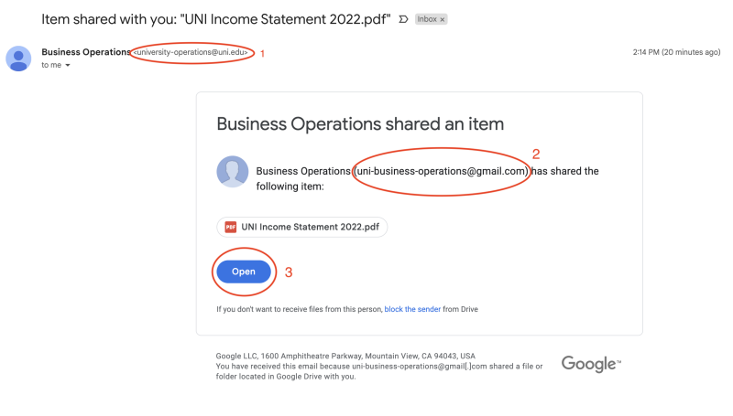
Google document share offer

Slide 6
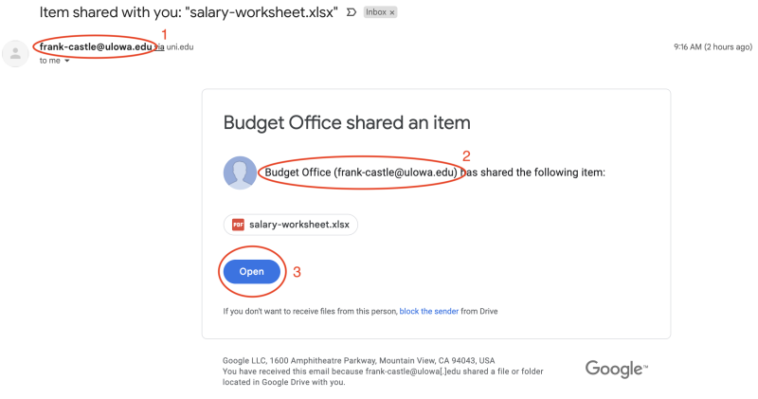
Another document share offer

Slide 7
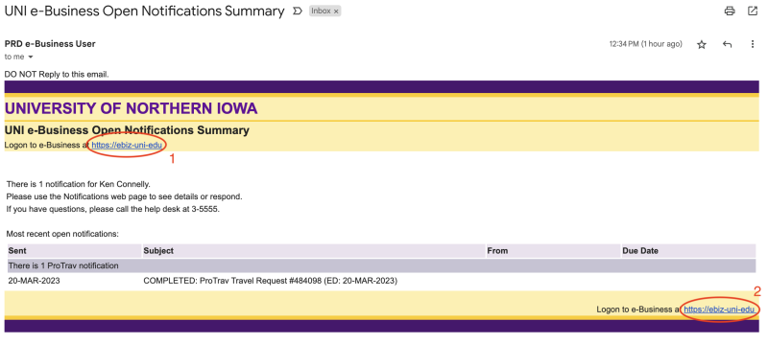
eBusiness – targeted attack

Slide 8
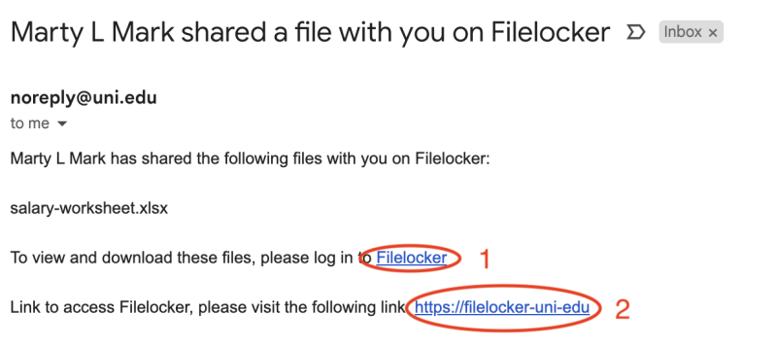
Filelocker – even more targeted!

Slide 9
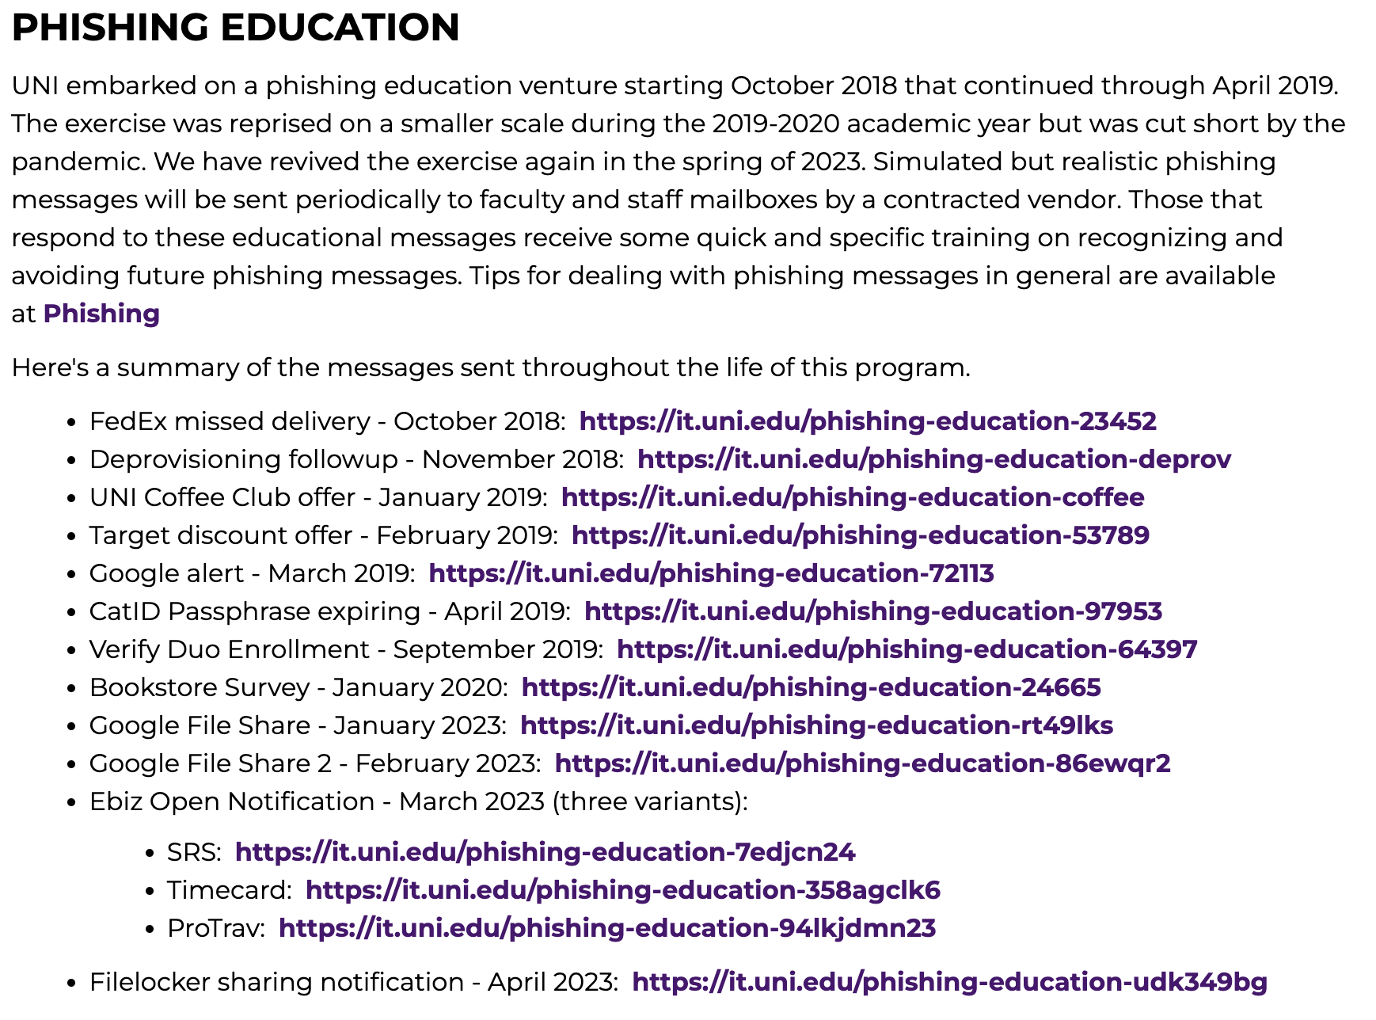
https://it.uni.edu/phishing-education

Slide 10
How do you recognize phishing?
Almost all phishing and other scams utilize one of these emotions
Fear: something bad will happen if you don’t click
Greed: something good will happen if you do click
Urgency: hurry up and CLICK RIGHT NOW
Concern/Empathy:
I’m stranded in an unfamiliar city
I’m falsely accused, in jail, and need bail money
I’ve been mugged and am in the hospital

Slide 11
How do you protect yourself?
Be skeptical!
Don’t click on links in email unless you’re certain that it’s a legitimate request
Hover over links before clicking, then don’t click!
Any request to divulge your UNI password via e-mail is fraudulent!

Slide 12
What do I do if I receive a phish?
Use Gmail tools to mark the message as such
Forward to phishing@uni.edu and security@uni.edu
Include full headers from the message if requested

Slide 13
Also…
Phone calls
Web pop-ups
You’re infected!
Call our support hotline!
Click here and let us help you fix it!

Slide 14
Security Awareness
Available to all faculty, staff, and students
Found as a course at https://training.uni.edu
Click on the “Data Security” link

Slide 15
Questions?
Contact info:
Ken Connelly
Ken.Connelly@uni.edu or 273-5850
Eric Lukens
Eric.Lukens@uni.edu or 273-7434
Doug Murray
Doug.Murray@uni.edu or 273-6467
Tyler Helmers
Tyler.Helmers@uni.edu or 273-5306
Or just security@uni.edu

