Slide 1
New Employee Orientation: Payroll and UNI Works
Jill Thrasher, Payroll Manager

Slide 2
Agenda
General Payroll Information
Navigating UNI Works
Pay
Time Tracking
Absences & Time Off Balances

Slide 3
General Payroll Information
103 Gilchrist
Office of Business Operations

Slide 4
General Payroll Information
Begin Date | End Date | Payday
12/22/2024 | 1/18/2025 | 1/31/2025
1/19/2025 | 2/15/2025 | 2/28/2025
2/16/2025 | 3/22/2025 | 3/31/2025
3/23/2025 | 4/19/2025 | 4/30/2025
4/20/2025 | 5/17/2025 | 5/30/2025
5/18/2025 | 6/21/2025 | 6/30/2025
6/22/2025 | 7/19/2025 | 7/31/2025
7/20/2025 | 8/16/2025 | 8/29/2025
8/17/2025 | 9/20/2025 | 9/30/2025
9/21/2025 | 10/18/2025 | 10/31/2025
10/19/2025 | 11/15/2025 | 11/26/2025
11/16/2025 | 12/20/2025 | 12/31/2025
12/21/2025 | 1/17/2026 | 1/30/2026
1/18/2026 | 2/14/2026 | 2/27/2026
When is payday?
Pay periods?
UNI Home page/Menu/A–Z Index/P/Payroll

Slide 5
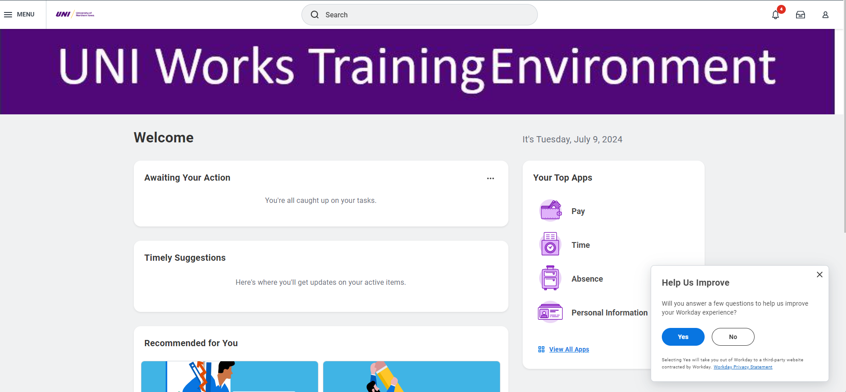
Navigating UNI Works

Slide 6
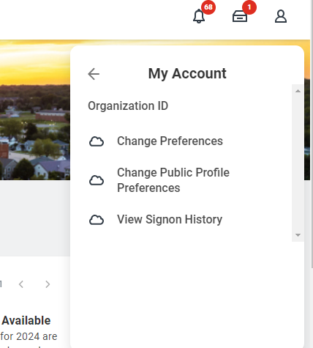
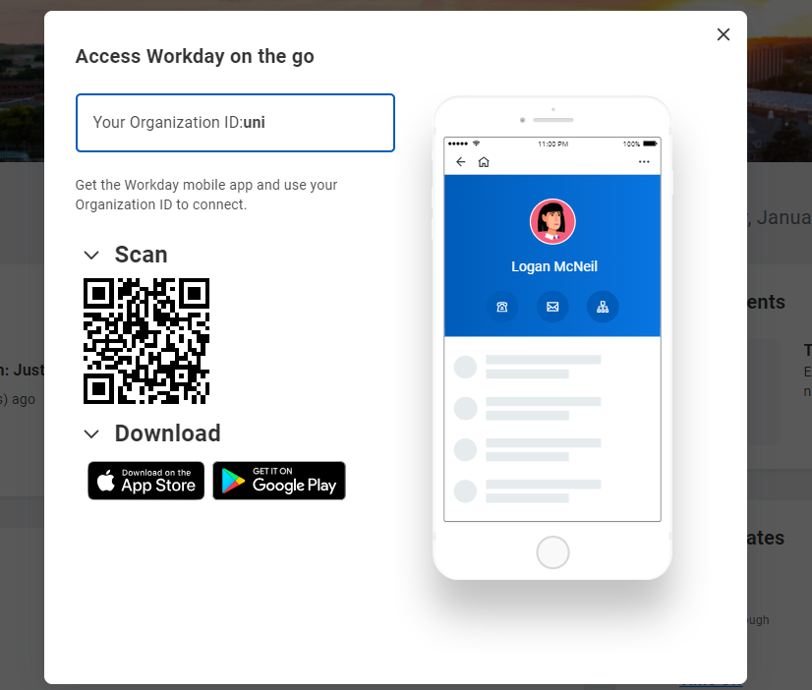
Navigating UNI Works

Slide 7
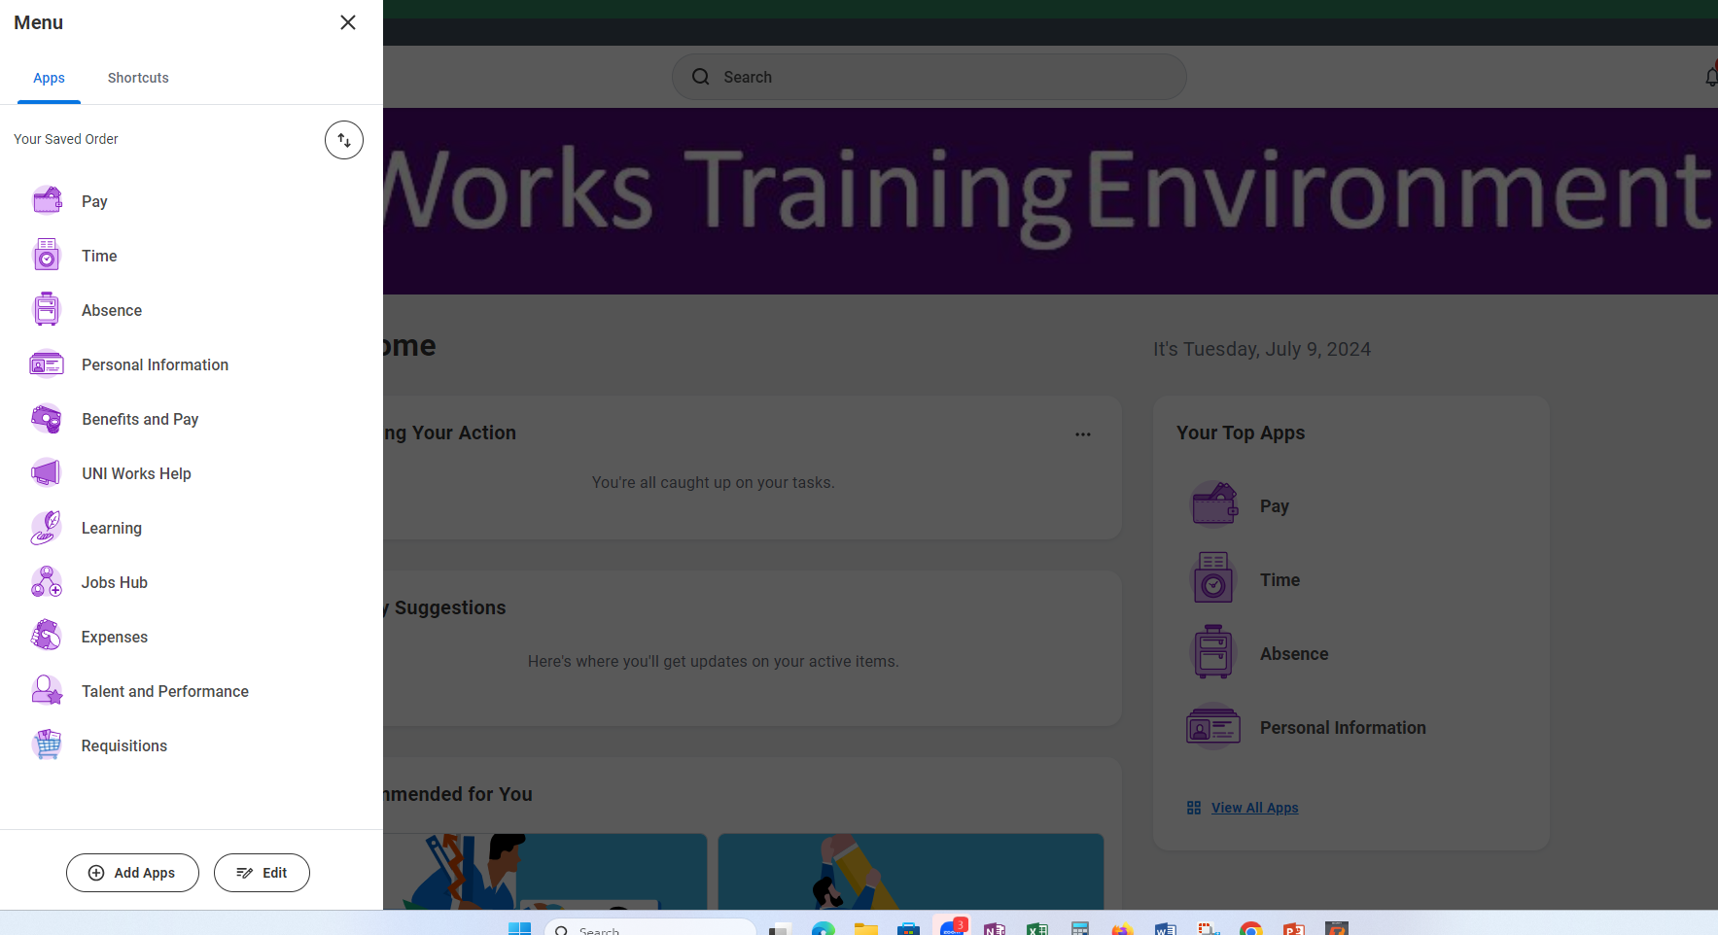
Navigating UNI Works

Slide 8
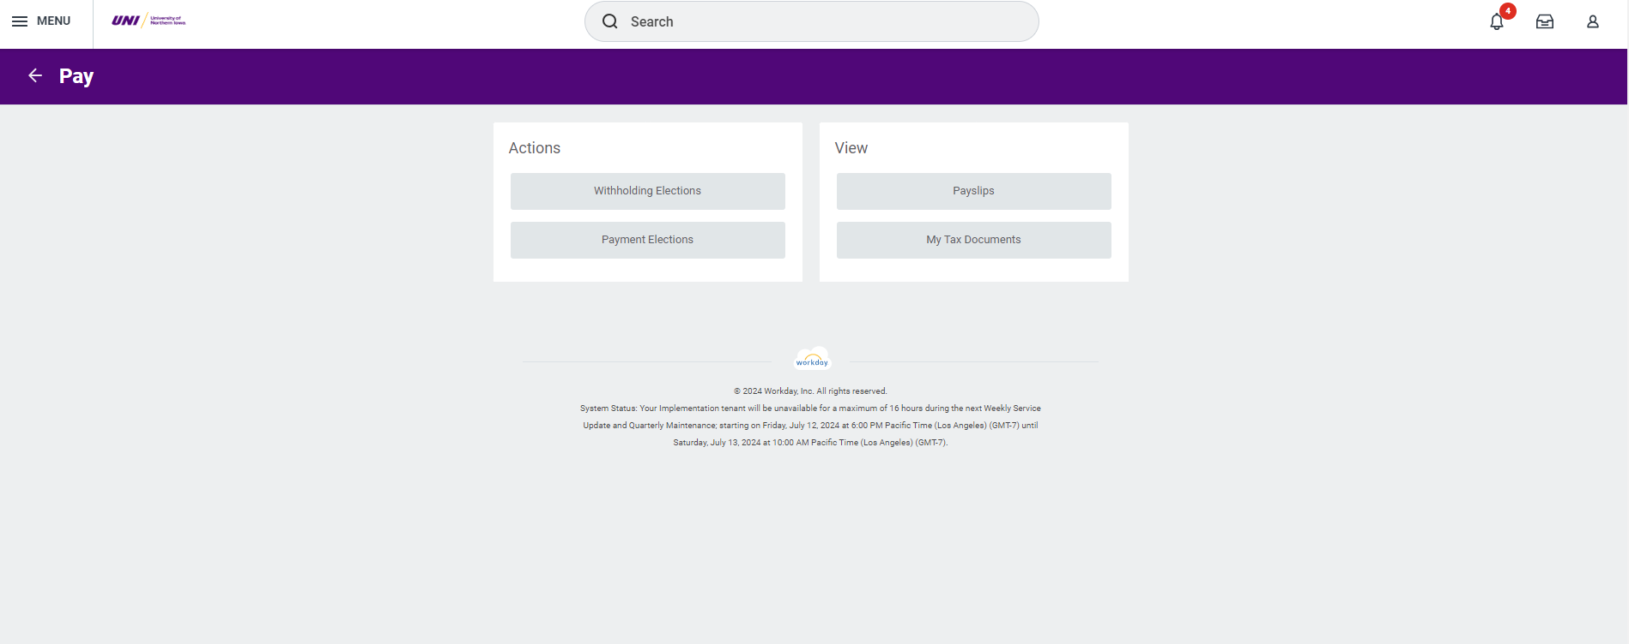
Pay App

Slide 9
Timecards
Who completes the timecards?
When is the deadline
Why is meeting the deadline so important?

Slide 10
Time App

Slide 11
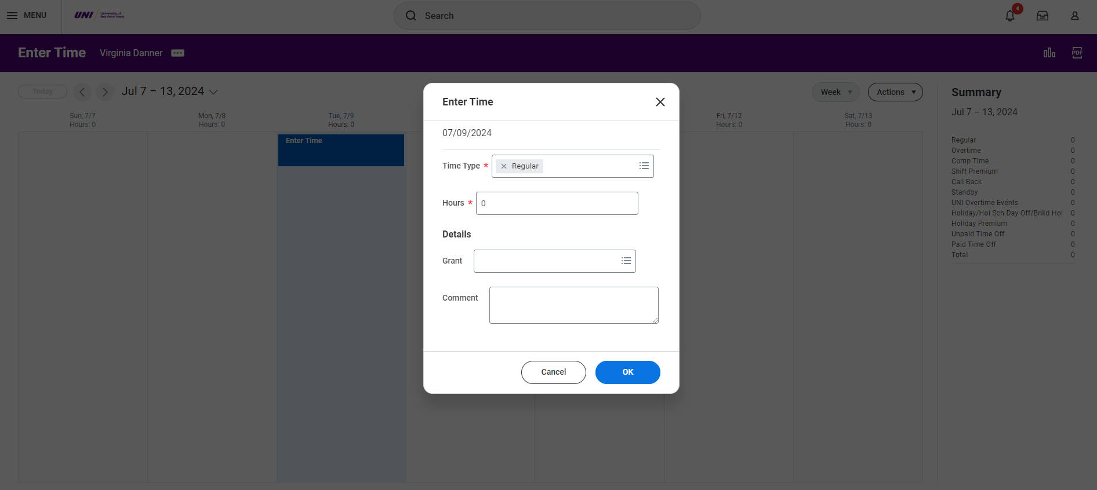
Time Tracking

Slide 12
Absence Balances
Who gets vacation and sick leave?
How much time?
When does it start? Holidays/Off Duty
Use the month AFTER it’s earned

Slide 13
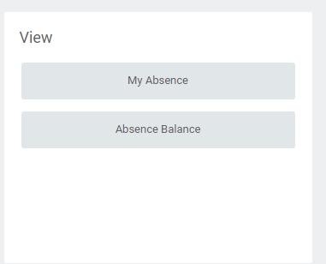
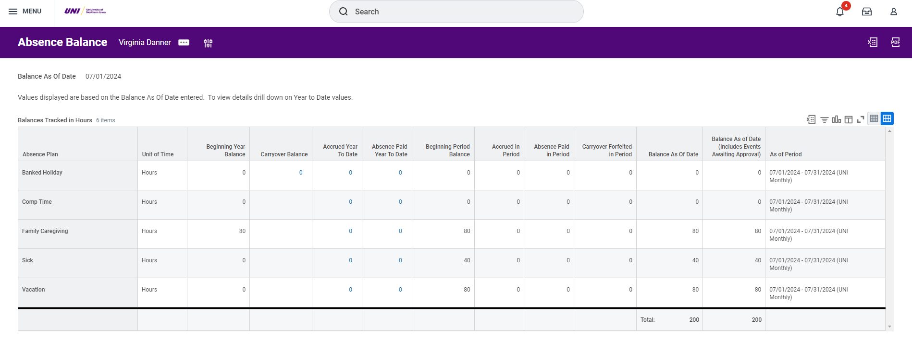
Absence Balance

Slide 14
Max Balance

Slide 15
Absences

Slide 16
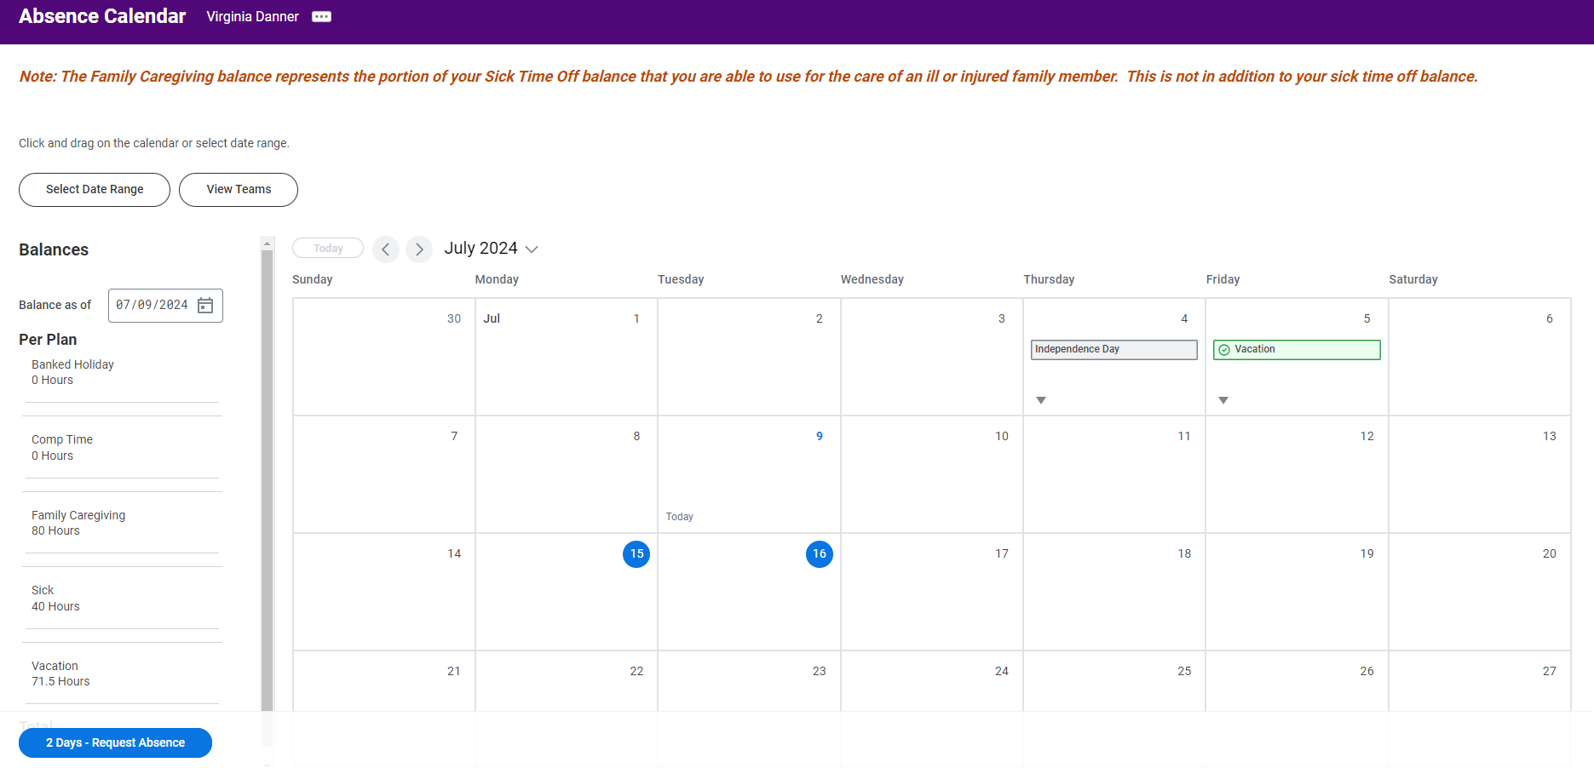
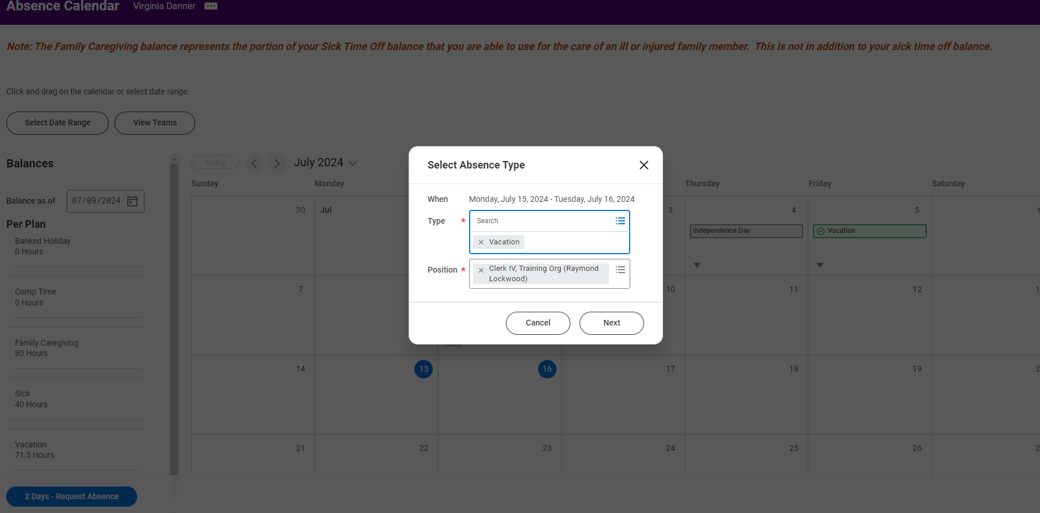
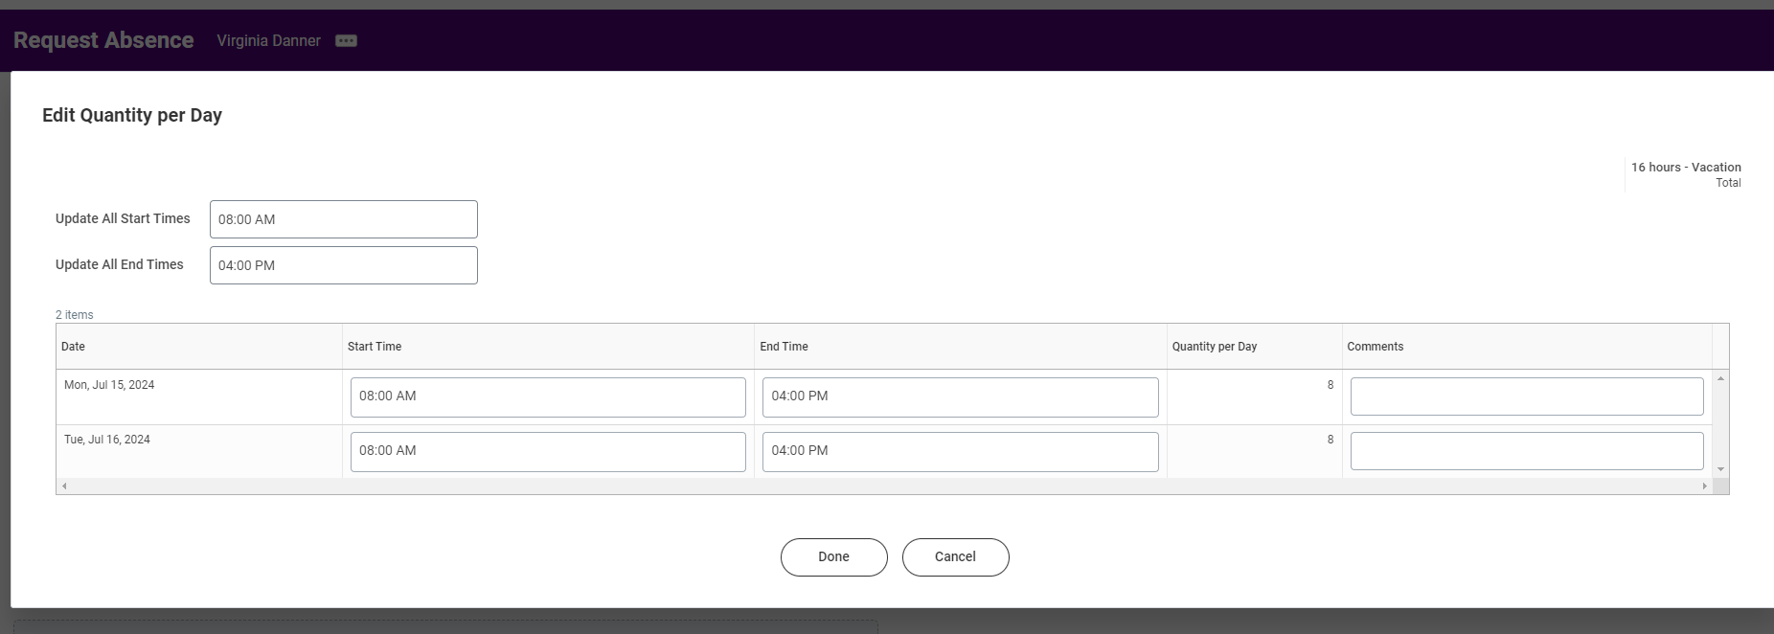
Request Absence

Slide 17
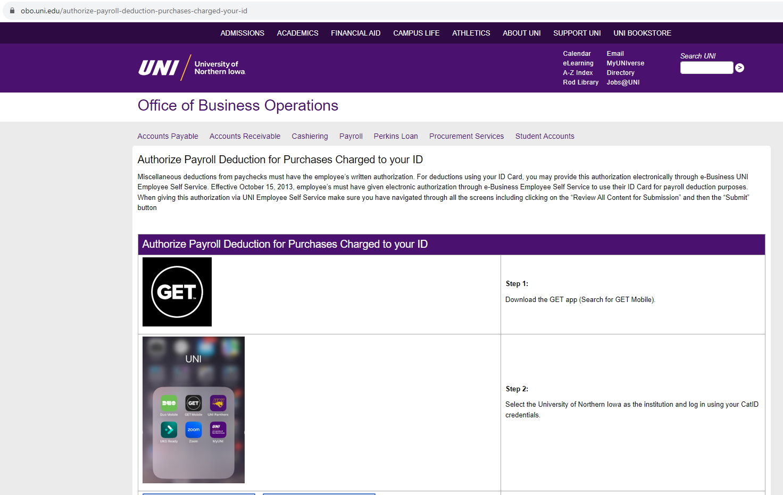
ID Charges

Slide 18
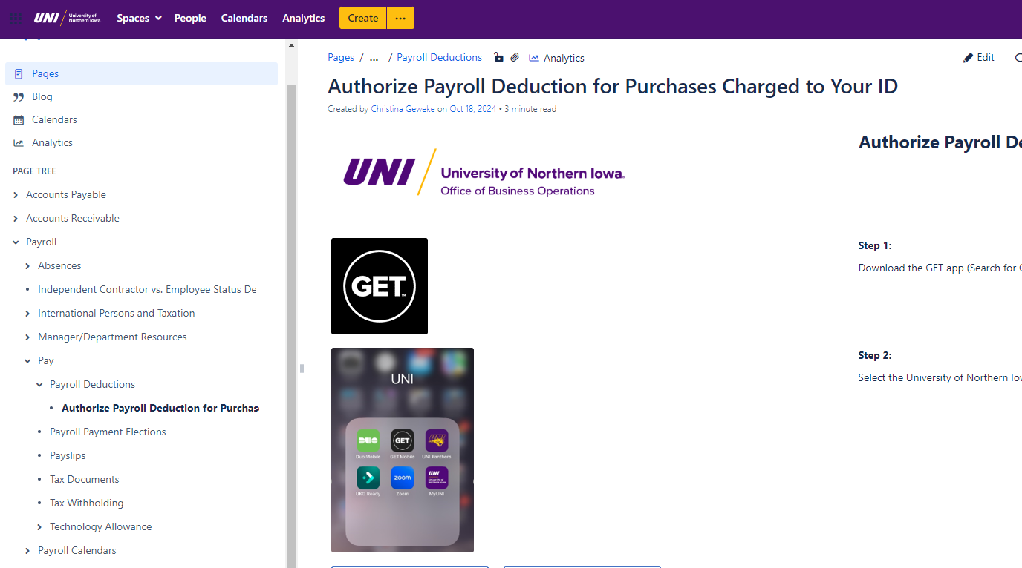
Payroll Deduction of I.D. charges
One-time authorization to allow UNI to deduct ID charges from your paycheck
GET app
OBO Service Hub/Payroll Deductions

Slide 19
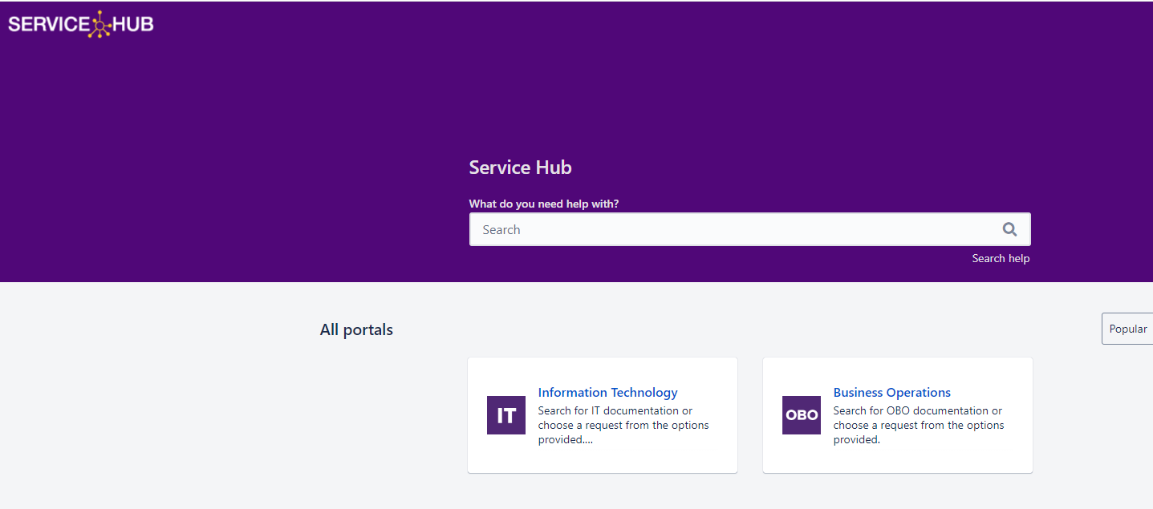
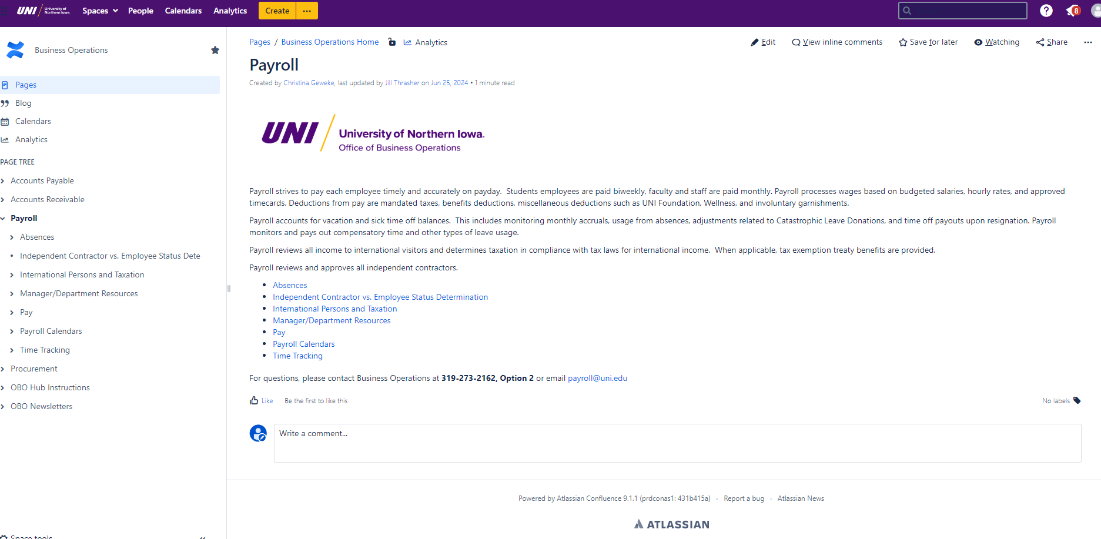
How to contact us:
UNI Home page/Menu/A–Z Index/P/Payroll
Business Operations Web Page
Business Operations Service Hub Page
Payroll@uni.edu
Payroll (319)273-2162, option 2

