Slide 1
Phishing Don’t Get Caught
Ken Connelly
IT-Information Security
Notes:
Introduce yourself
Introduce department
Thank them and HR for their time
“Hi, I’m Joe Security and I’m one of five people in the IT-Information Security department. I thank you for joining us and thanks to HR for providing this time to go over the important issue of phishing and IT security.”

Slide 2
Classic Phishing Example
Dear Staff and student,
This is to inform all staff and student of University of Northern lowa, that due to the congestion in the school web-mail account and removal of all unused accounts an upgrade is needed, kindly update your email account by filling the form below.
User Name
Email Id
Password
This information will be used to upgrade your account to avoid lost. Failure to do this your account will be De-activated.
Thank you.
University of Northern lowa webmail Team.
IT Information Security
Notes:
Long ago, phishing messages just asked for the username and password in a reply to an email. While less common, this still occasionally happens.

Slide 3
Any request to divulge your UNI password is fraudulent!
IT Information Security
Notes:
If somebody from UNI asks for your CatID password, please contact us right away! It is a policy violation to share your CatID passwords. Ask for IT help if multiple users need access to a data or a computer system.
Very rarely there may be a shared password for IoT devices or “appliance-like” systems. Those passwords must be unique and cannot be the same as anyone’s CatID password. Historically, there were shared passwords for some departmental accounts for generic email addresses. Those are being migrated to better solutions.

Slide 4
Unfortunately… It has gotten a lot worse
Multiple methods: email, phone, SMS, web pop-ups, file shares, meeting invites, etc.
Mimicking real messages and web pages
Messages customized for each recipient
Full-time job as phisher/attackers
IT Information Security
Notes:
Phishing is not just an email problem...some might not call those other attacks phishing, but rather social engineering attacks. We’re going with phishing because it is more recognized. There’s also spear-phishing, a highly-customized, targeted attack. SMS might be known as smishing. Phone call attacks are quite common and deep fake AI voice manipulation makes this worse.
Many of the attackers are full-time employees of criminal organizations or foreign governments. They have quotas, bonuses, and incentives just like any other employee.

Slide 5
How to Spot Phishing
Fear – Something bad will happen if you don’t click
Urgency – Need help right now, don’t wait
Greed – Something good will happen if you do click
Obligation – Part of your duties or something you might have the ability to do, just not usually
Guilt – Claims to have incriminating information
Concern/empathy – Needs your help specifically
IT Information Security
Notes:
At a deep level, it is all emotional manipulation. There is little difference between phishing and a psychological ops campaign. These same things would apply to anyone attempting to manipulate your thought process at any time.
If anyone pedantic complains about greed being listed under fear, greed is the fear of missing out or not getting what you think you deserve. Same emotional target. Same with Concern/empathy’s relationship with guilt, it is the part of the thought process we’re looking at.

Slide 6
How to Spot Phishing
Fear – Pretend to be supervisor or high-level official
Urgency – Action requested needs near immediate response
Greed – Reward for action
Obligation – Action must be done, but often can’t be done in the usual manner
Guilt – Claims that action has been repeatedly requested
Concern/empathy – Desire to help and be helpful
IT Information Security
Notes:
The more of these you spot, the more skeptical you should be.

Slide 7
How to Spot Phishing
Fear – Your account will be terminated!
Urgency – Payment is overdue
Greed – You’ve won an award for best <<insert title>> in USA!
Obligation – I’m in a meeting and unable to speak by phone. Need you to order something.
Guilt – We have your web history. We’ve seen your web cam.
Concern/empathy – I’m falsely accused and need bail!
IT Information Security
Notes:
Additional examples:
Fear – There is unusual activity on your account. Any fear of failure, punishment, or consequences.
Obligation – Claims of legal requirements.
Guilt – People dependent on you will face consequences. For example, “Foreign student will be deported.”
Concern/empathy – I was assaulted and am in the hospital. I’m stranded in an unfamiliar city. The traditional grandparent scam.

Slide 8
How to Spot Phishing
Fear Obligation Guilt FOG
Trick you into rash actions without thinking it through
Deviate from proper procedures
Hide their intentions
Appeal to emotions
IT Information Security
Notes:
The end goal, bypass your normal skepticism and safe-guards via emotional manipulation via FOG.
Of course, there are times the attackers will just fake a totally normal, benign message hoping some will fall for it. These are the hardest to spot based on the content of the message. In those cases, you need to look at where the links take you.

Slide 9
How to Protect Yourself
Be skeptical
Slow down
Avoid clicking links in email
Hover over links before clicking
Double-check the URL of websites
Feel free to ask us if unsure
Never share passwords or MFA Codes
IT Information Security
Notes:
Mistakes are made when people rush or panic. Hovering over links before clicking and double-checking the URL when entering credentials or sensitive data is a must. This is much more tricky on phones. If you’re unsure and it can wait, look at it on a desktop later. If its urgent, send it to us anyway.
For the AI/deepfake concerns, strike up a short conversation with the person on something off-topic, if they can’t quickly respond, something might be amiss. This is most important for last minute financial changes.
Sometimes you can see something is bogus by looking at the sender of an email. This is subject to false negatives but not false positives.
Email us at security@uni.edu for anything you’re worried about with tech if you think there’s an IT security implication or a potential loss of confidential UNI data, if we’re not quite the right people, we’ll get you in touch with who you need.

Slide 10
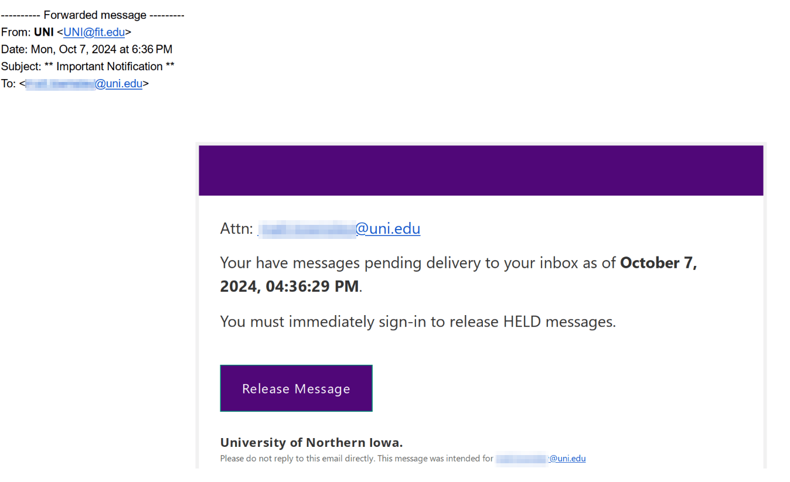
Notes:
This is a real phishing message that was targeted at UNI.

Slide 11
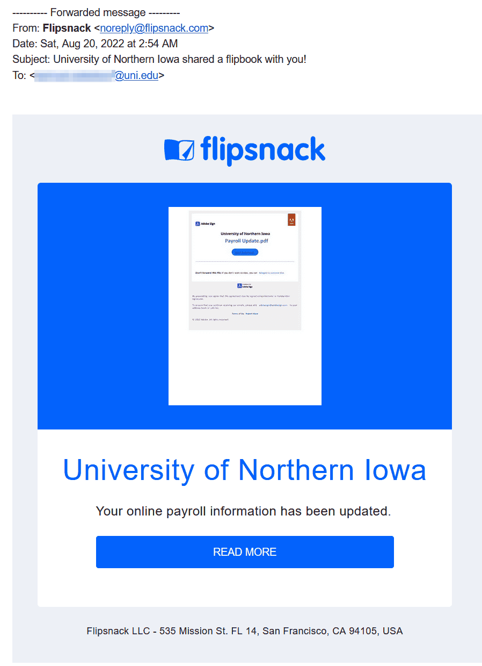
If a third-party service is used that you have not seen UNI use before, be very skeptical and check with IT-Information Security or your supervisor.
Notes:
This is also a real phishing message that was targeted at a number of UNI users.

Slide 12
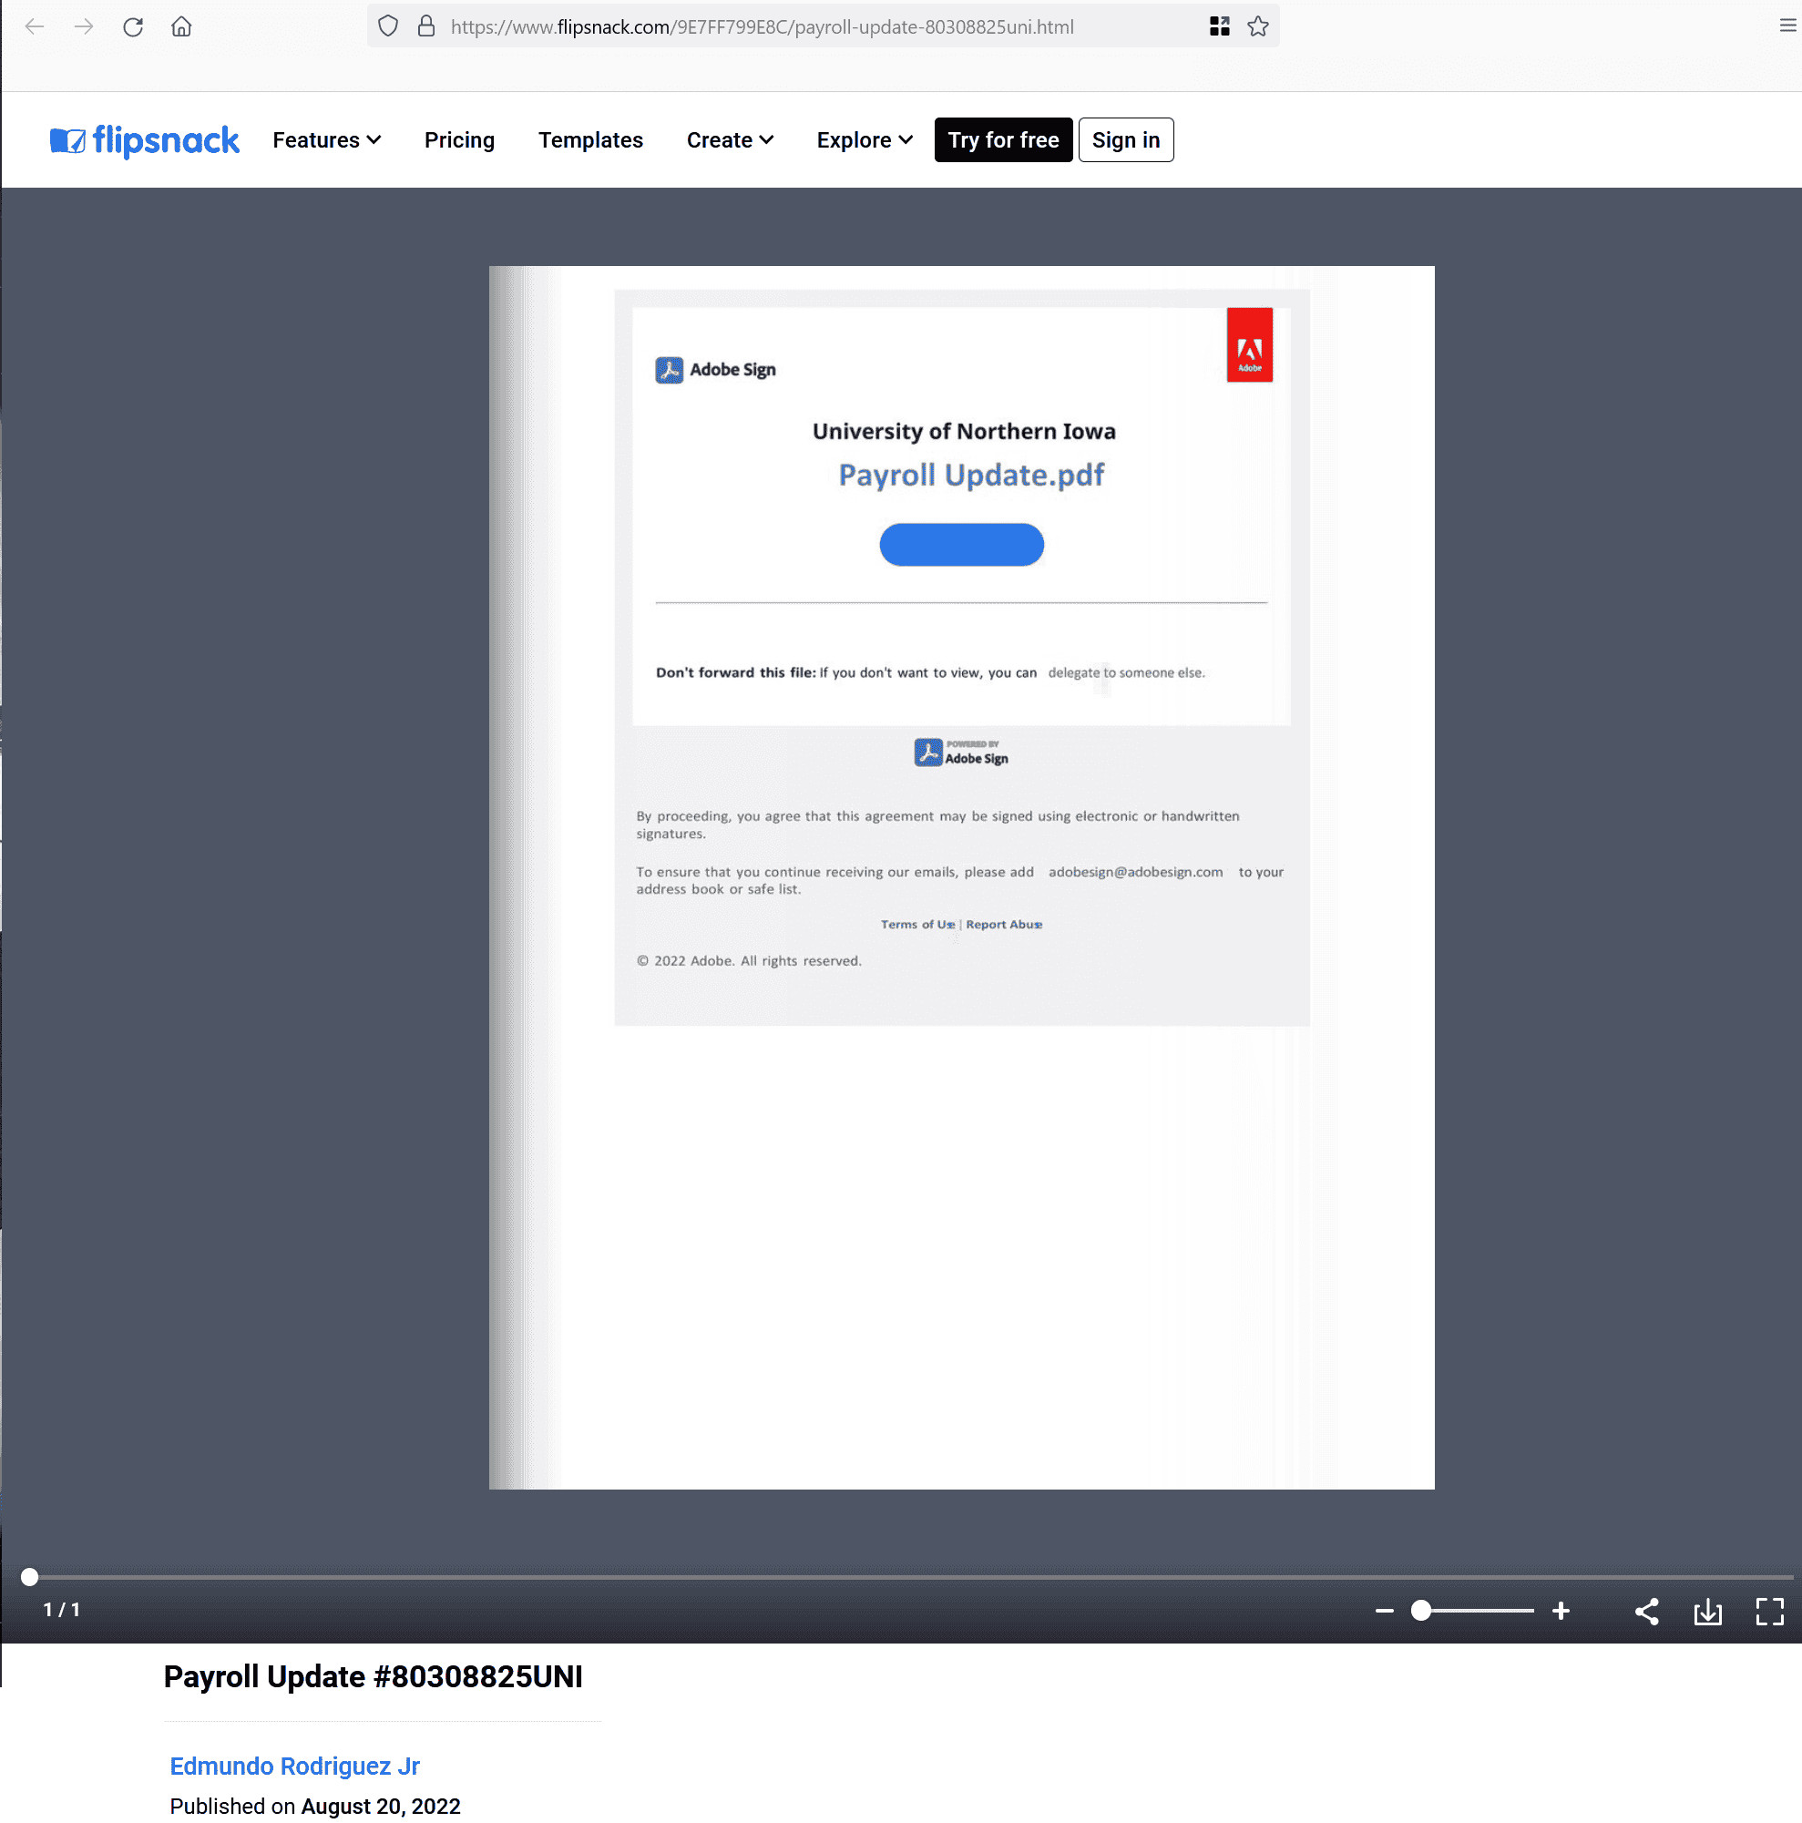
Phishers often use multiple layers via many services to make their attack harder to detect.
Notes:
This is a continuation of the last phish had you clicked on it. They’d have tried to trick you by displaying something that seems more trustworthy, but is really just a link to yet another page. If clicked, this takes you to the final target of this phish.
Note the use of multiple services.

Slide 13
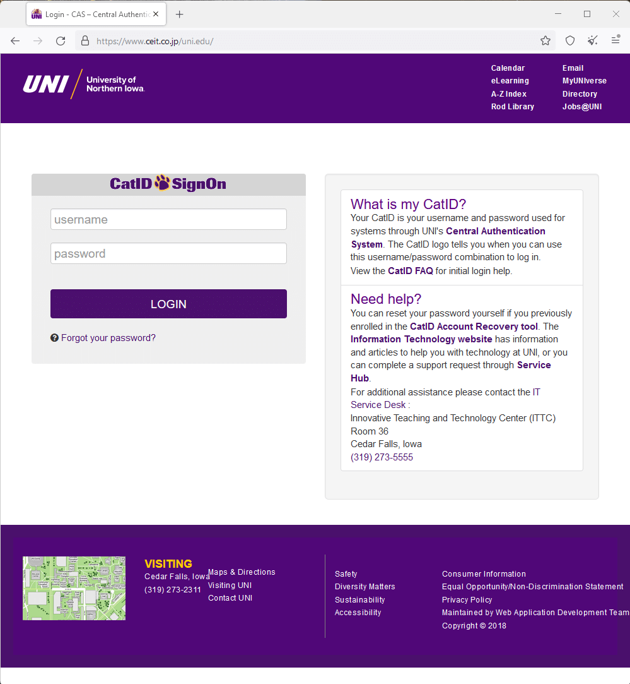
Notes:
Now we have a fake copy of the UNI logon page. It is a perfect replica except for the URL. Indeed, it is even delivered over HTTPS. Notes about checking for HTTP vs. HTTPS are mostly irrelevant now as HTTPS is almost always required to be used.
Its not always game over when you click a phishing link…often additional steps need to be taken for the phish to lead to an actual compromise. Just be honest about it when reporting. The email, then the FlipSnack page were abuses of legitimate services and had no security impact on their own. They just were used to hide the link to the untrustworthy site mimicking the UNI CatID log on page.

Slide 14
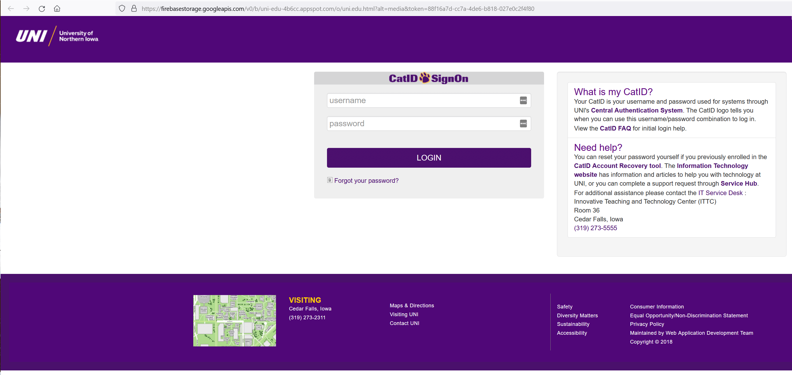
Attackers hosted this one on Google. Google never took it down.
Notes:
In another real phishing attack, a Google service was manipulated to host the fake logon page. As this Google service is used by Google apps and millions of websites, it is essentially unblockable. Had we blocked that URL, nearly all work at UNI would have halted. Additionally, traffic to this server is completely normal and expected.

Slide 15
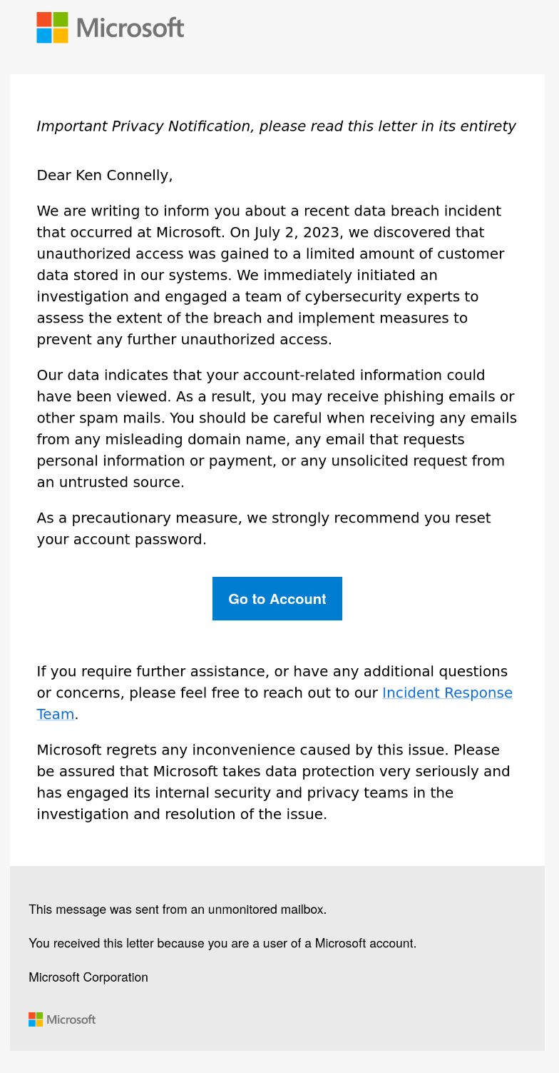
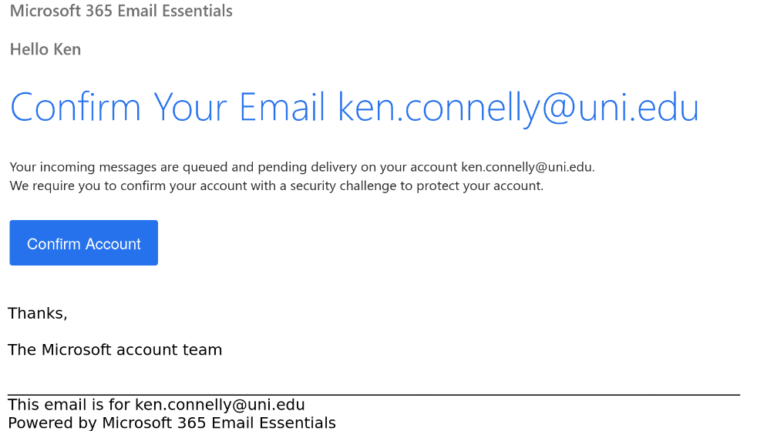
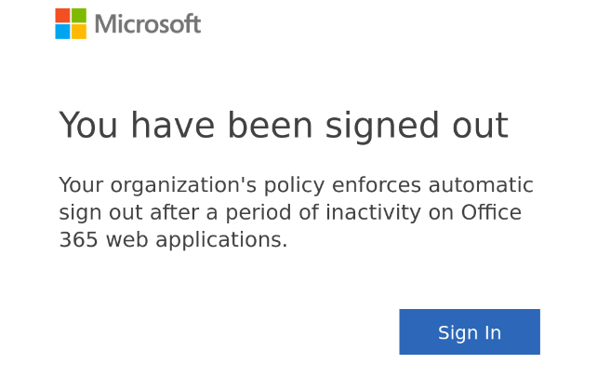
Notes:
This is a collage of various simulated phishing messages that are based on real phishing messages. In each case, the only way to tell it was fake was to hover over the link to see it went to a page that didn’t make sense, or to notice that the sender was unusual.

Slide 16
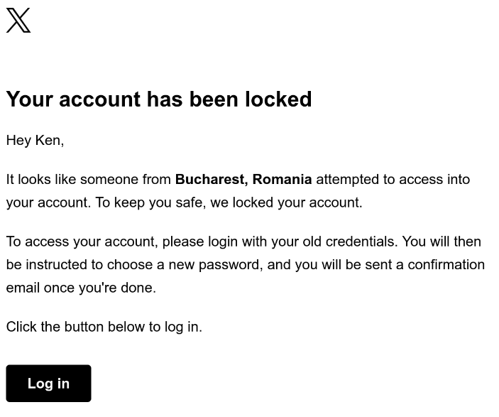
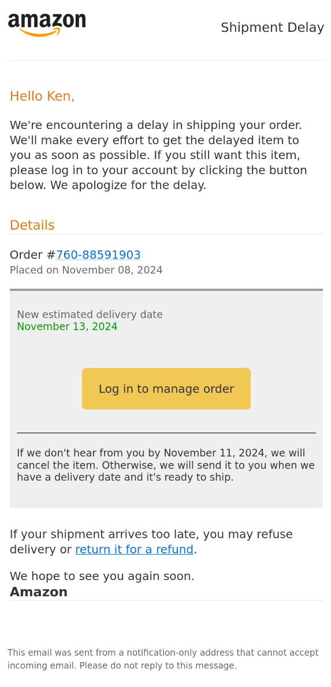
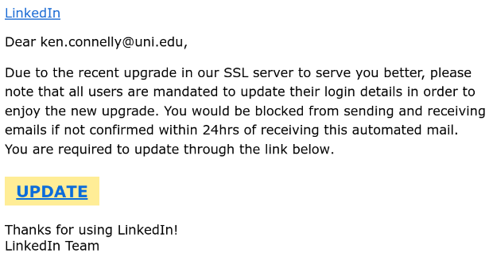
Notes:
Services not related to UNI can still be used to help gain a foothold. Keeping work and personal accounts separate helps avoid this.
This is a collage of various simulated phishing messages that are based on real phishing messages. In each case, the only way to tell it was fake was to hover over the link to see it went to a page that didn’t make sense, or to notice that the sender was unusual.

Slide 17
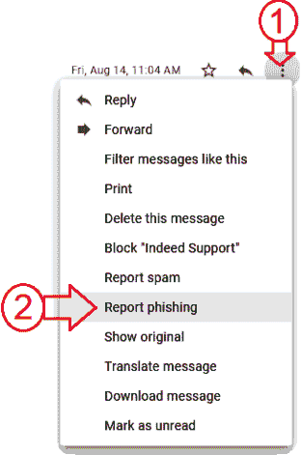
What if I get a phish?
Forward to phishing@uni.edu
Mark the message as a phish in Gmail
You may be asked for full headers; we’ll give instructions if that happens.
IT Information Security
Notes:
If you accidentally send to security@uni.edu instead, that’s fine, it just helps with automation and future-proofing our infrastructure. If you send to both, that’s fine too.
Reporting spam and phishing appropriately via the Gmail tools helps train the Google algorithms to block similar messages.
Reporting phishing to phishing@uni.edu helps us secure accounts by looking for users that may have received the message but didn’t report it. Further, on some attacks, particularly against people in a certain role at UNI, we will inform other educational institutions to look out for the same thing.

Slide 18
Phishing Education Project
Simulated but realistic phishing messages are sent periodically to faculty and staff mailboxes by a contracted vendor.
Respond or Click? Receive some quick and specific training on recognizing and avoiding future phishing messages.
IT Information Security
Notes:
The results are kept anonymous and are non-punitive, so long as you consider a training message non-punitive.

Slide 19
Security Awareness Training
Available to all faculty, staff, and students
Found as a course at https://training.uni.edu
Click on the “Security Awareness” option
IT Information Security

Slide 20
Questions?
Ken Connelly
Ken.Connelly@uni.edu
319-273-5850
Eric Lukens
Eric.Lukens@uni.edu
319-273-7434
Doug Murray
Doug.Murray@uni.edu
319-273-6467
Tyler Helmers
Tyler.Helmers@uni.edu
319-273-5306
security@uni.edu
Best option, sends to whole team
IT Information Security
Notes:
Ask for questions
Thank them again
Remind them again that security@uni.edu is a place to send anything they’re worried about Information Security wise.

